Slide 1


Vehicles Moving Along Roads (Linked List)
This presentation explores how linked lists, a fundamental data structure, can model the movement of vehicles along roads. Linked lists provide a dynamic and efficient way to manage and represent vehicles in motion.
by Kushal Patel

Slide 2
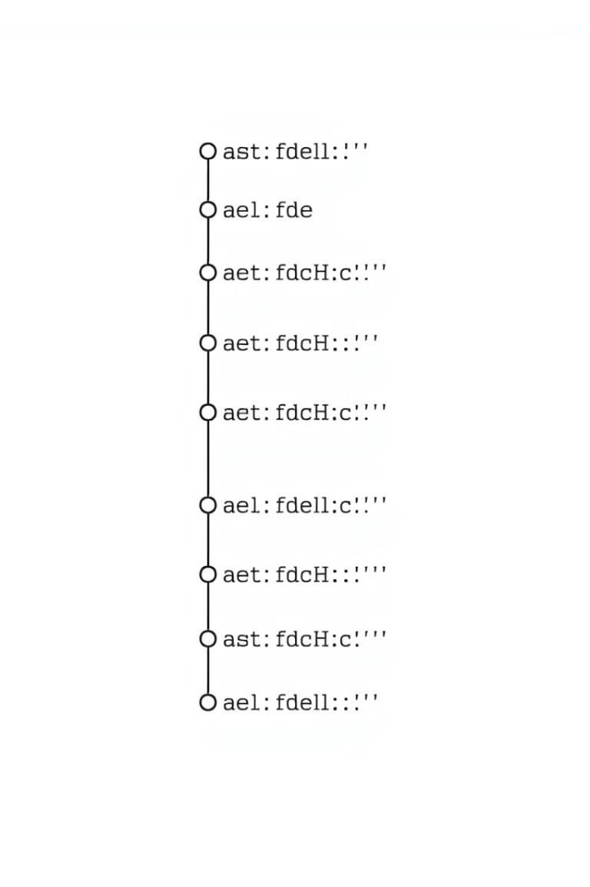
Introduction
1
Data Organization
2
Linked Lists: Dynamic Data Structures
Data structures are crucial for organizing and managing data effectively, enabling efficient access and manipulation.
Linked lists are dynamic data structures that allow flexible allocation and deallocation of memory, making them ideal for situations with changing data sizes.
3
Modeling Vehicle Movement
This presentation demonstrates how linked lists can effectively model the movement of vehicles on roads, illustrating the concept with clear examples.

Slide 3
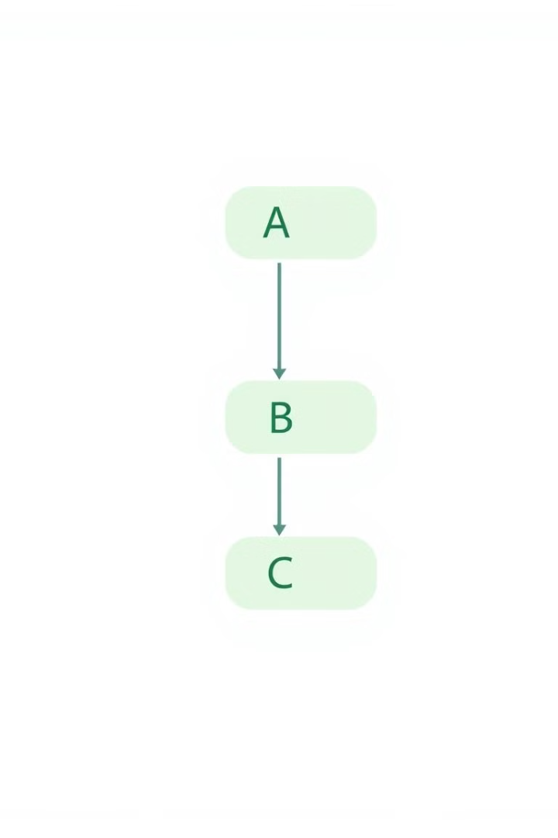
What is a Linked List?
Chain of Nodes
Types of Linked Lists
A linked list is a linear data structure composed of interconnected nodes. Each node contains data and a pointer to the next node in the sequence.
There are different types of linked lists: singly linked lists, doubly linked lists, and circular linked lists, each with specific characteristics and applications.
Dynamic Memory Allocation
Linked lists excel at dynamic memory allocation, allowing for efficient insertion and deletion of nodes without needing to predefine the list's size.

Slide 4




Application Overview
Vehicles as Nodes
Each vehicle on the road can be represented as a node in the linked list, containing information like the vehicle's type and current location.
Pointers as Roads
The pointers within the linked list act as connections between vehicles, signifying the road they are traveling on and the direction of movement.
Dynamic Updates
As vehicles move, the pointers in the linked list are dynamically updated, reflecting the changes in their positions on the road network.

Slide 5

Data Flow and Representation
1
Vehicle Placement
Vehicles are initially placed on the road network, which corresponds to the linked list structure. Each vehicle becomes a node in the list.
2
Dynamic Pointer Updates
As vehicles move, the pointers in the linked list are updated to reflect their new positions. This ensures accurate tracking of vehicle movements.
3
Insertion and Deletion
Adding or removing vehicles from the road network corresponds to insertion or deletion operations in the linked list, maintaining the integrity of the structure.

Slide 6
Linked List Operations in Vehicle Management
Insertion
Deletion
Adding a new vehicle to the road network involves inserting a new node into the linked list. This can be done at the head, tail, or any desired position within the list.
Removing a vehicle from the road network corresponds to deleting a node from the linked list. This involves updating the pointers to maintain the list's structure.

Slide 7




Advantages of Linked Lists in Vehicle Simulation
Dynamic Memory Allocation
Linked lists provide flexible memory allocation, allowing for efficient handling of varying traffic volumes and dynamic changes in the road network.
Efficient Insertion and Deletion
Linked lists enable efficient insertion and deletion operations, making them ideal for simulating real-time updates in traffic conditions.
Scalability
Linked lists scale well with increasing traffic volumes, making them suitable for modeling large and complex road networks.

Slide 8
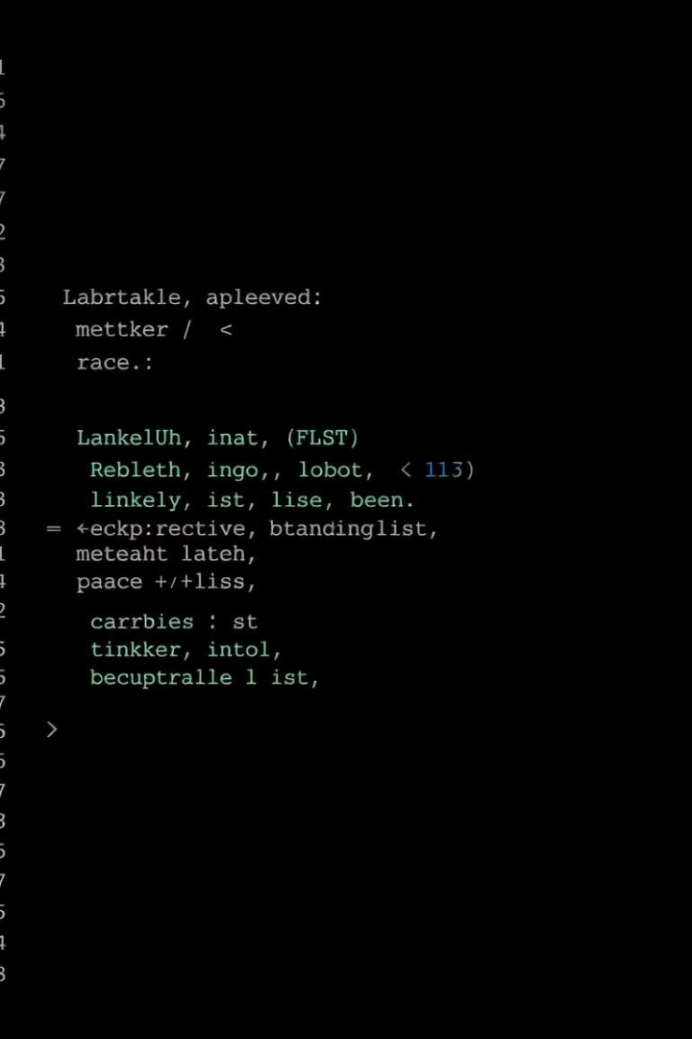
Live Coding Example
Code Example
Explanation
Insert a new vehicle at the head of the list
This code demonstrates the insertion of a new vehicle node at the beginning of the linked list representing the road.
Delete a vehicle from the list
This code shows the removal of a vehicle node from the linked list, updating the pointers to maintain the list's integrity.

Slide 9

Conclusion
1
Efficient Simulation
2
Real-Time Updates
Linked lists provide an efficient and flexible method for modeling vehicle movement on roads, adapting to dynamic traffic conditions.
The dynamic nature of linked lists allows for efficient insertion and deletion operations, facilitating real-time updates in traffic simulations.
3
Memory Management and Scalability
Linked lists offer efficient memory management and scalability, making them suitable for handling large and complex road networks with varying traffic loads.

